Slide 1
360 Analysis Tools
Shahriar’s Analytical Academy

Slide 2

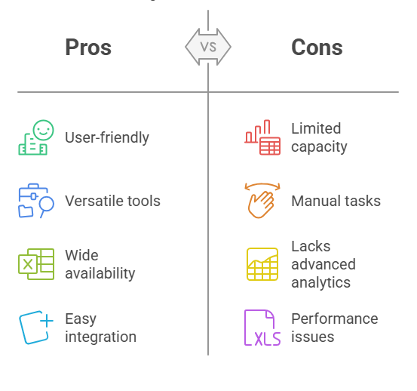
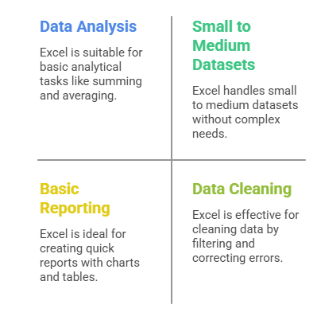
Microsoft Excel
Excel is a spreadsheet application developed by Microsoft. It is widely used for data entry, data analysis, and visualization. Excel allows users to organize data into rows and columns, perform calculations, and create graphs and charts.
Notes:
Excel is a spreadsheet application developed by Microsoft. It is widely recognized as one of the most powerful tools for managing data in various formats. Excel allows users to organize data into rows and columns, making it easy to store, analyze, and visualize information. Users can perform calculations using formulas, create graphs and charts, and even automate tasks using macros. It's particularly useful for business, finance, education, and many other industries where data organization and analysis are essential.
When to Use Excel?
Excel is best used when you need to handle small to medium-sized datasets that do not require complex processing. For instance, if you're analyzing sales data or creating a budget, Excel offers quick and easy solutions to perform basic data analysis, such as summing values, averaging, or identifying trends. It's also helpful when you need to generate reports or visualize data in the form of graphs or pivot tables. Moreover, if you're cleaning data—removing duplicates or correcting errors—Excel provides an intuitive platform for these tasks.
Advantages
Ease of Use: Excel is widely recognized for its user-friendly interface. Even beginners can quickly grasp its basic features like entering data, using basic formulas, and creating charts.
Versatility: Excel is a versatile tool suitable for basic analysis, data manipulation, and visualization. It is ideal for tasks such as creating tables, performing simple mathematical operations, and generating various chart types.
Data Manipulation: Excel has powerful built-in features like pivot tables, VLOOKUP, and IF statements, which allow users to perform complex data manipulations and make decisions based on large amounts of data.
Wide Availability: Most organizations use Excel, making it a common tool for collaboration and data sharing. It’s also available as part of the Microsoft Office suite, ensuring compatibility across devices.
Integration: Excel integrates well with other Microsoft tools like Word, PowerPoint, and Access, making it easier to work across various software applications.
Disadvantages
Limited Capacity: Excel struggles with handling extremely large datasets, especially those that exceed a million rows, where it may experience performance issues.
Manual: Many tasks in Excel, such as data entry and formatting, are manual. This increases the risk of human error, especially when working with large datasets.
Lack of Advanced Analytics: While Excel is great for basic analysis, it is not suitable for advanced tasks like machine learning or big data analytics, which require specialized tools and programming languages.
Performance: Complex formulas, especially those used in larger datasets, can slow down Excel. It may take longer to process the data, reducing efficiency when working with substantial or complicated datasets.

Slide 3
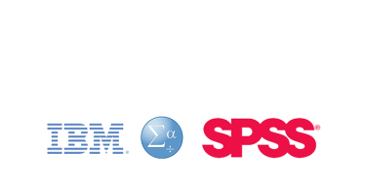
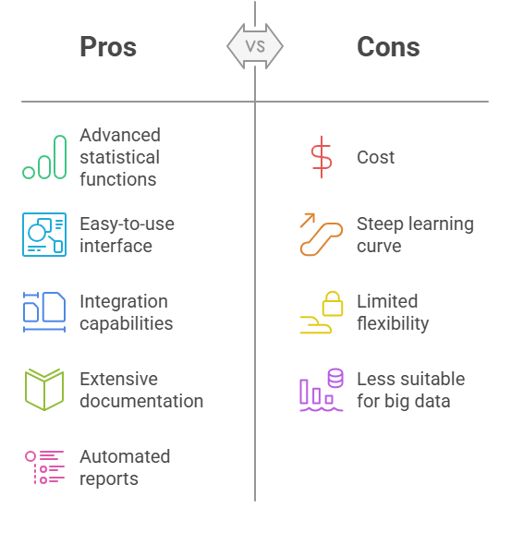
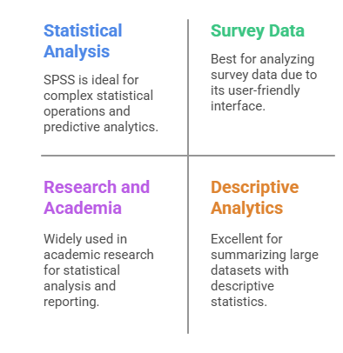
IBM SPSS
SPSS (Statistical Package for the Social Sciences) is a software used for statistical analysis. It is highly favored in social science, marketing, and healthcare research. SPSS allows for easy data manipulation, statistical analysis, and the creation of high-quality reports and charts.
Notes:
IBM SPSS (Statistical Package for the Social Sciences) is a software application used for statistical analysis. It is particularly popular in research fields such as social sciences, marketing, and healthcare. SPSS allows users to perform a wide range of statistical tests and procedures and is known for its user-friendly interface. Researchers and analysts use it to analyze data, perform hypothesis testing, regression analysis, and create high-quality reports with graphs and charts.
When to Use IBM SPSS?
SPSS is ideal when you need to perform complex statistical analysis or work with large survey datasets. It excels in areas like hypothesis testing, regression analysis, and predictive modeling. SPSS is often used in research and academia to analyze experimental data and summarize findings through descriptive statistics. If you have survey data, SPSS provides an intuitive environment for cleaning, analyzing, and visualizing the results. It’s also useful for anyone who needs to report statistical findings clearly and accurately, thanks to its built-in reporting features.
Advantages
Advanced Statistical Functions: SPSS provides a wide range of statistical tests, including t-tests, ANOVA, chi-square tests, and advanced regression models. This makes it an excellent tool for researchers and data analysts who need to perform in-depth statistical analysis.
Easy-to-Use Interface: Unlike some statistical software that requires programming knowledge, SPSS provides a graphical interface (GUI) that makes it accessible to non-programmers, which is particularly useful for people without a technical background.
Integration: SPSS can work seamlessly with various data formats such as Excel, CSV, and SQL databases, which is beneficial for those who need to import or export data from other sources.
Extensive Documentation: SPSS comes with comprehensive documentation, tutorials, and customer support, making it easier for users to learn the software and resolve issues when needed.
Automated Reports: SPSS offers features that automate the generation of reports, saving time on repetitive tasks. This is particularly valuable in research projects where regular reporting is required.
Disadvantages
Cost: Unlike open-source tools like R or Python, SPSS is a paid software. The cost may be prohibitive for smaller organizations, independent researchers, or students.
Steep Learning Curve: While the GUI is user-friendly, mastering SPSS’s advanced features requires some time and effort, especially for users unfamiliar with statistical analysis.
Limited Flexibility: SPSS may not be as customizable as other open-source alternatives like R or Python, especially for more advanced or custom statistical modeling.
Less Suitable for Big Data: SPSS is not designed for handling big data or conducting machine learning tasks. It may struggle with extremely large datasets and is less suitable for real-time data analysis.

Slide 4
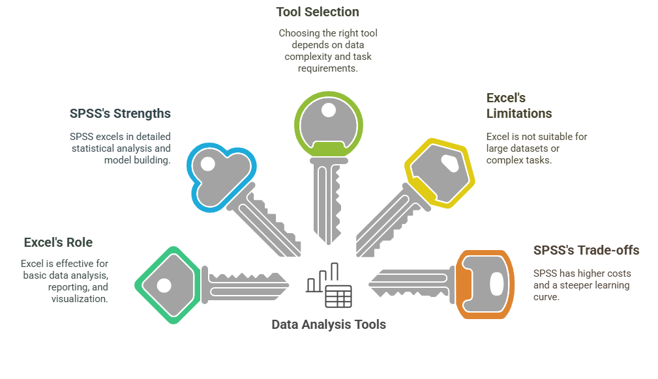
5 Key Learning Points of this Lesson
Notes:
Excel’s Role in Data Science
Excel is a great tool for getting started with data science, especially for basic analysis, data visualization, and reporting. It’s perfect for handling small datasets and simple calculations. However, it’s not suitable for more advanced tasks like big data processing or machine learning, where specialized tools are required.
SPSS for Advanced Statistical Analysis
IBM SPSS is a robust tool designed for more complex statistical analysis. It is commonly used in fields like research, social sciences, and healthcare to conduct hypothesis testing, regression analysis, and other sophisticated analyses. SPSS provides a comprehensive set of tools for researchers who need to generate statistically valid results and detailed reports.
Choosing the Right Tool for the Task
Choosing between Excel and SPSS depends on the task at hand. If you’re dealing with a small dataset that requires basic analysis and visualization, Excel is the right tool. However, if your analysis involves advanced statistical techniques or large datasets, SPSS is more suitable
Excel’s Limitations
While Excel is incredibly versatile, it has its limitations. Its capacity to handle large datasets is restricted, and complex formulas can slow it down. Additionally, Excel is not ideal for performing advanced statistical analyses or machine learning.
SPSS’s Strength in Data Science
SPSS excels in providing advanced statistical analysis and can handle large datasets, making it ideal for researchers who need to conduct in-depth analysis. Its user-friendly interface and ability to perform complex modeling and testing set it apart from tools like Excel

Slide 5
Thank You!
Shahriar’s Analytical Academy

